Slide 1
Module 17: Public Key Cryptography
Networking Security v1.0
(NETSEC)
Notes:
Networking Security (NETSEC) Module 17: Public Key Cryptography

Slide 2
Module Objectives
Module Title: Public Key Cryptography
Module Objective: Explain how a public key infrastructure is used to ensure data confidentiality and provide authentication.
Topic Title | Topic Objective
Public Key Cryptography with Digital Signatures | Explain public key cryptography.
Authorities and the PKI Trust System | Explain how the public key infrastructure functions.
Applications and Impacts of Cryptography | Explain how the use of cryptography affects cybersecurity operations.
Notes:
2
17 – Public Key Cryptography
17.0.2 – What will I learn to do in this module?

Slide 3
17.1 Public Key Cryptography with Digital Signatures
Notes:
17: Public Key Cryptography 17.1: Public Key Cryptography with Digital Signatures

Slide 4
Public Key Cryptography
Digital Signature Overview
Digital signatures are a mathematical technique used to provide authenticity, integrity, and nonrepudiation.
The following are characteristics of digital signatures:
Authentic - The signature cannot be forged and provides proof that the signer, and no one else, signed the document.
Unalterable - After a document is signed, it cannot be altered.
Not reusable- The document signature cannot be transferred to another document.
Non-repudiated - The signed document is considered to be the same as a physical document.
Notes:
17: Public Key Cryptography 17.1: Public Key Cryptography with Digital Signatures 17.1.1: Digital Signature Overview

Slide 5
Public Key Cryptography
Digital Signature Overview (Cont.)
Digital signatures are commonly used in the following two situations: code signing and digital certificates.
There are three Digital Signature Standard (DSS) algorithms that are used for generating and verifying digital signatures:
Digital Signature Algorithm (DSA) - DSA is the original standard for generating public and private key pairs, and for generating and verifying digital signatures.
Rivest-Shamir Adelman Algorithm (RSA) - RSA is an asymmetric algorithm that is commonly used for generating and verifying digital signatures.
Elliptic Curve Digital Signature Algorithm (ECDSA) - ECDSA is a newer variant of DSA and provides digital signature authentication and non-repudiation with the added benefits of computational efficiency, small signature sizes, and minimal bandwidth.
Notes:
17: Public Key Cryptography 17.1: Public Key Cryptography with Digital Signatures 17.1.1: Digital Signature Overview

Slide 6
Public Key Cryptography
Digital Signatures for Code Signing
Executable files are wrapped in a digitally signed envelope, which allows the end user to verify the signature before installing the software.
Digitally signing code provides several assurances about the code.
The code is authentic and is actually sourced by the publisher.
The code has not been modified since it left the software publisher.
The publisher undeniably published the code. This provides nonrepudiation of the act of publishing.
Notes:
17: Public Key Cryptography 17.1: Public Key Cryptography with Digital Signatures 17.1.2: Digital Signatures for Code Signing

Slide 7
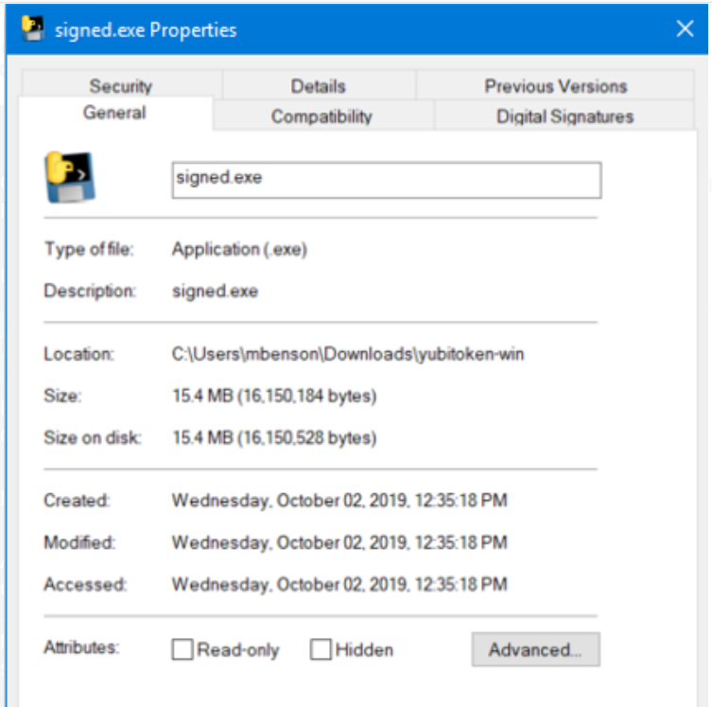
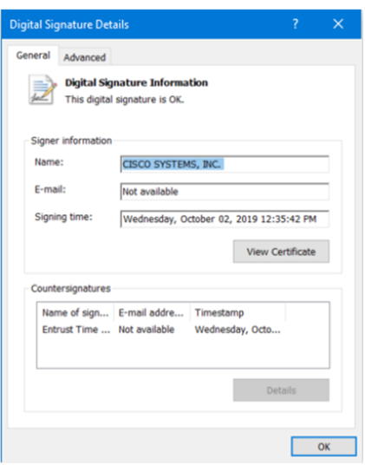
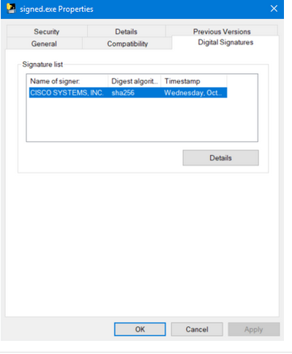
Public Key Cryptography
Digital Signatures for Code Signing (Cont.)
This executable file was downloaded from the internet. The file contains a software tool from Cisco Systems.
Clicking the Digital Signatures tab reveals that the file is from a trusted organization, Cisco Systems Inc.
The Digital Signature Details window reveals that the file was signed by Cisco Systems, Inc in October of 2019.
Notes:
17: Public Key Cryptography 17.1: Public Key Cryptography with Digital Signatures 17.1.2: Digital Signatures for Code Signing

Slide 8
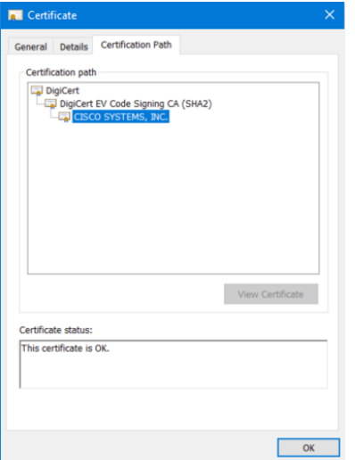
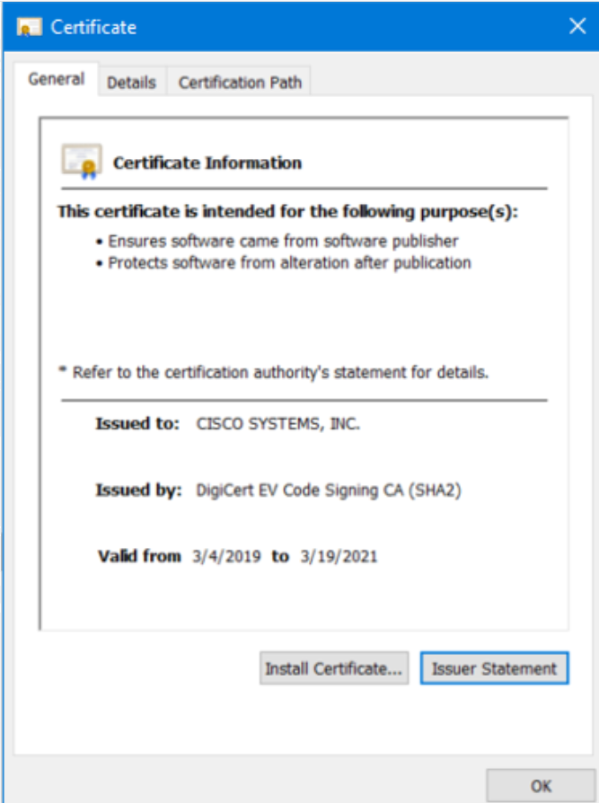
Public Key Cryptography
Digital Signatures for Code Signing (Cont.)
The Certificate Information tab provides the purposes of the certificate, who the certificate was issued to, and who issued the certificate. It also displays the period for which the certificate is valid.
The Certification Path tab to see the file was signed by Cisco Systems, as verified to DigiCert.
Notes:
17: Public Key Cryptography 17.1: Public Key Cryptography with Digital Signatures 17.1.2: Digital Signatures for Code Signing

Slide 9
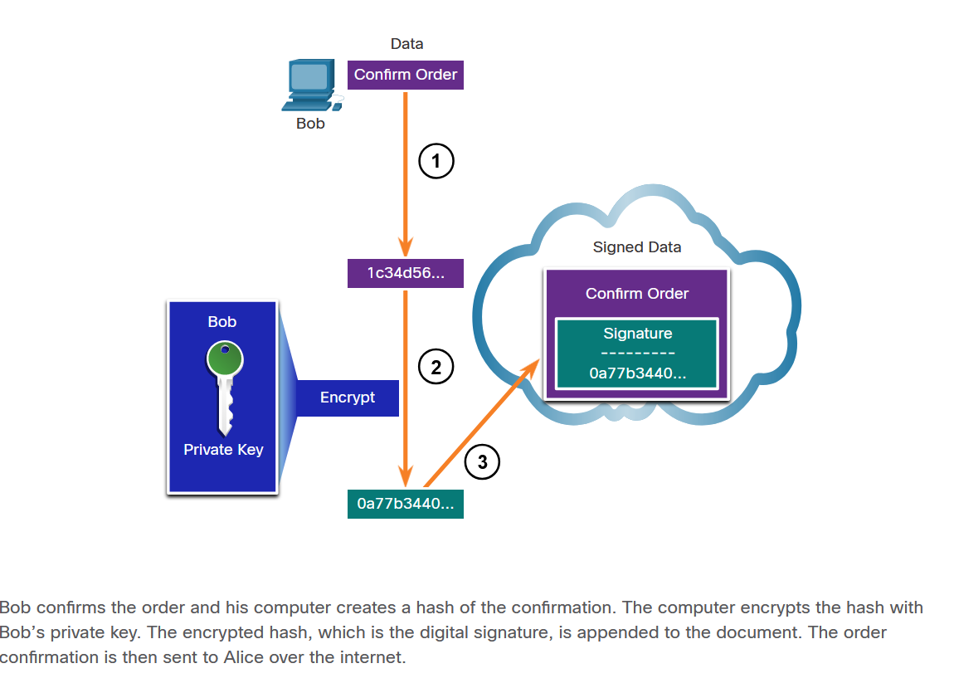
Public Key Cryptography
Digital Signatures for Digital Certificates
A digital certificate is used to authenticate and verify that a user who is sending a message is who they claim to be. Digital certificates can also be used to provide confidentiality for the receiver with the means to encrypt a reply.
This scenario will help you understand how a digital signature is used. Bob is confirming an order with Alice. Alice is ordering from Bob’s website. Alice has connected with Bob’s website, and after the certificate has been verified, the Bob’s certificate is stored on Alice’s website. The certificate contains Bob’s public key. The public key is used to verify the Bob’s digital signature.
Notes:
17: Public Key Cryptography 17.1: Public Key Cryptography with Digital Signatures 17.1.3: Digital Signatures for Digital Certificates

Slide 10
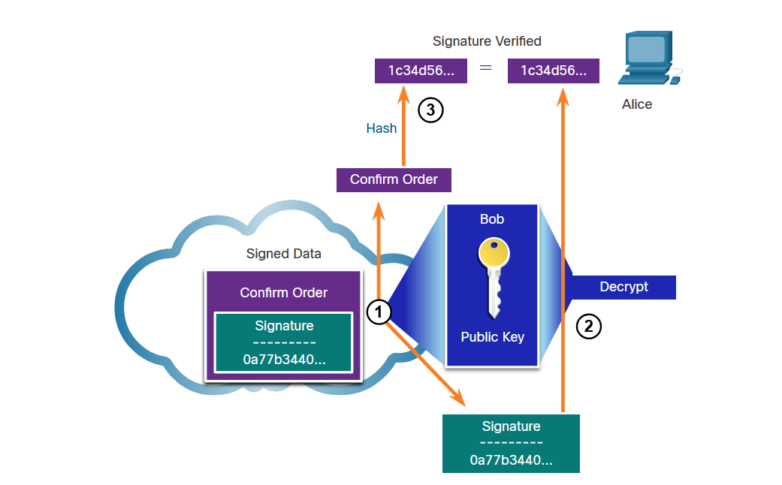
Public Key Cryptography
Digital Signatures for Digital Certificates (Cont.)
When Alice receives the digital signature, the following process occurs:
Alice’s receiving device accepts the order confirmation with the digital signature and obtains Bob’s public key.
Alice’s computer then decrypts the signature using Bob’s public key. This step reveals the assumed hash value of the sending device.
Alice’s computer creates a hash of the received document, without its signature, and compares this hash to the decrypted signature hash. If the hashes match, the document is authentic.
Notes:
17: Public Key Cryptography 17.1: Public Key Cryptography with Digital Signatures 17.1.3: Digital Signatures for Digital Certificates

Slide 11
17.2 Authorities and the PKI Trust System
Notes:
17: Public Key Cryptography 17.2: Authorities and the PKI Trust System

Slide 12
Public Key Cryptography
Public Key Management
When establishing an asymmetric connection between two hosts, the hosts will exchange their public key information.
An SSL certificate is a digital certificate that confirms the identity of a website domain. To implement SSL on your website, you purchase an SSL certificate for your domain from an SSL Certificate provider.
The trusted third party does an in-depth investigation prior to the issuance of credentials. After this in-depth investigation, the third-party issues credentials (i.e., digital certificate) that are difficult to forge. From that point forward, all individuals who trust the third party simply accept the credentials that the third-party issues.
Some examples of Certificate Authorities (CAs) are IdenTrust, DigiCert, Sectigo, GlobalSign, and GoDaddy. These CAs charge for their services. Let’s Encrypt is a non-profit CA that offers certificates free of charge.
Notes:
17: Public Key Cryptography 17.2: Authorities and the PKI Trust System 17.2.1: Public Key Management

Slide 13
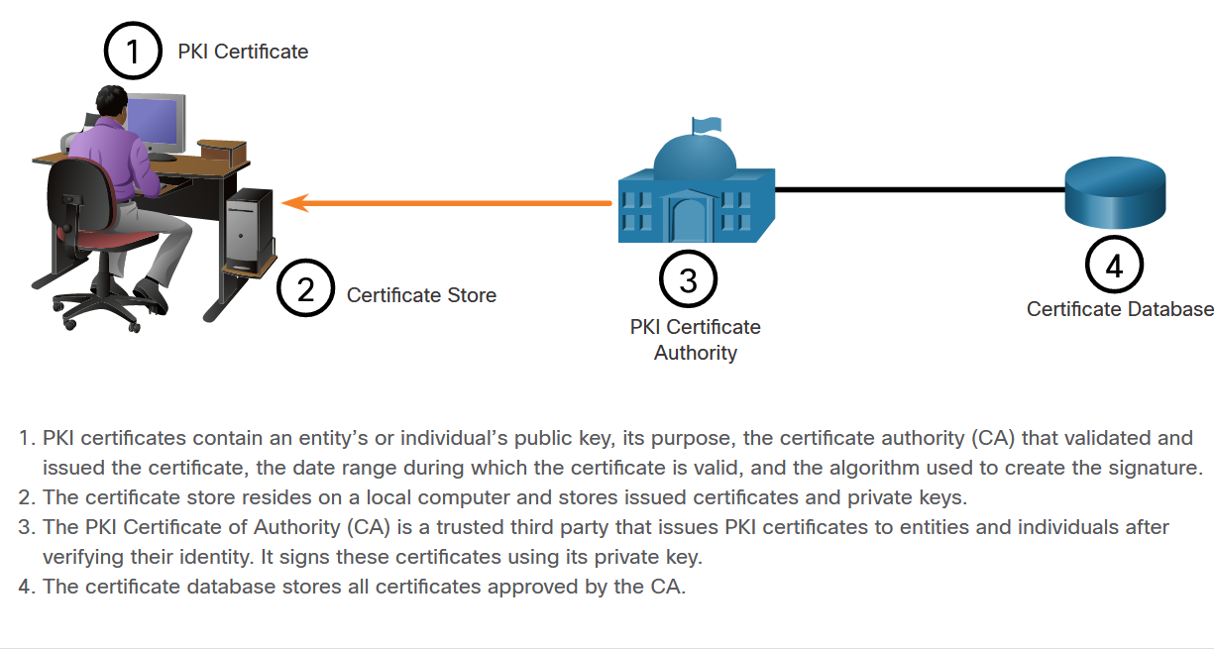
Public Key Cryptography
Public Key Infrastructure
PKI is needed to support large-scale distribution and identification of public encryption keys. The figure shows the main elements of the PKI.
Notes:
17: Public Key Cryptography 17.2: Authorities and the PKI Trust 17.2.2: Public Key Infrastructure

Slide 14
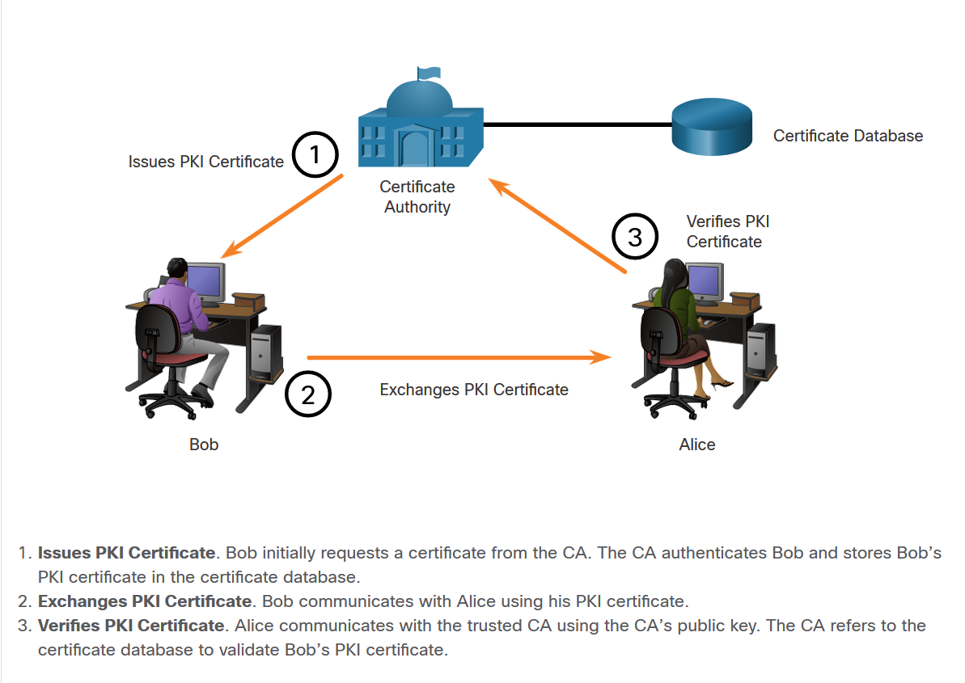
Public Key Cryptography
Public Key Management (Cont.)
The next figure shows how the elements of the PKI interoperate:
In this example, Bob has received his digital certificate from the CA. This certificate is used whenever Bob communicates with other parties.
Bob communicates with Alice.
When Alice receives Bob’s digital certificate, she communicates with the trusted CA to validate Bob’s identity.
Notes:
17: Public Key Cryptography 17.2: Authorities and the PKI Trust System 17.2.2: Public Key Infrastructure

Slide 15
Public Key Cryptography
The PKI Authorities System
CAs, especially those that are outsourced, issue certificates based on classes which determine how trusted a certificate is.
The table provides a description of the classes. The class number is determined by how rigorous the procedure was that verified the identity of the holder when the certificate was issued. The higher the class number, the more trusted the certificate.
Class | Description
0 | Used for testing in situations in which no checks have been performed.
1 | Used by individuals who require verification of email.
2 | Used by organizations for which proof of identity is required.
3 | Used for servers and software signing. Independent verification and checking of identity and authority is done by the certificate authority.
4 | Used for online business transactions between companies.
5 | Used for private organizations or government security.
Notes:
17: Public Key Cryptography 17.2: Authorities and the PKI Trust System 17.2.2: The PKI Authorities System

Slide 16
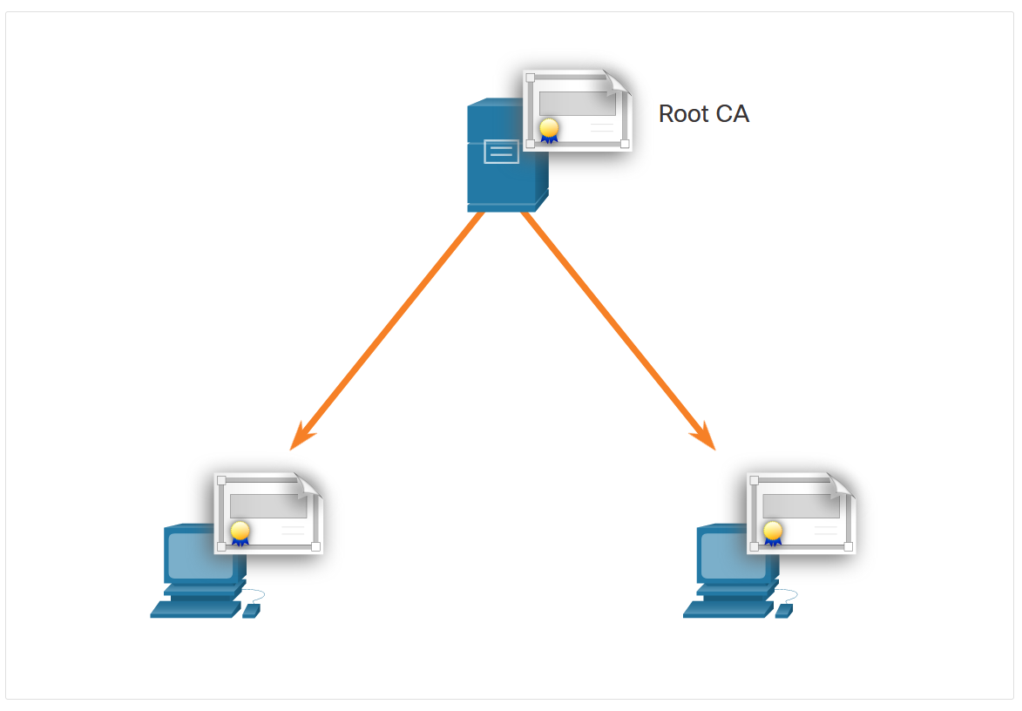
Public Key Cryptography
The PKI Trust System
PKIs can form different topologies of trust. The simplest is the single-root PKI topology.
As shown in the figure, a single CA, called the root CA, issues all the certificates to the end users, which are usually within the same organization. The benefit to this approach is its simplicity. However, it is difficult to scale to a large environment because it requires a strictly centralized administration, which creates a single point of failure.
Notes:
17: Public Key Cryptography 17.2: Authorities and the PKI Trust System 17.2.4: The PKI Trust System

Slide 17
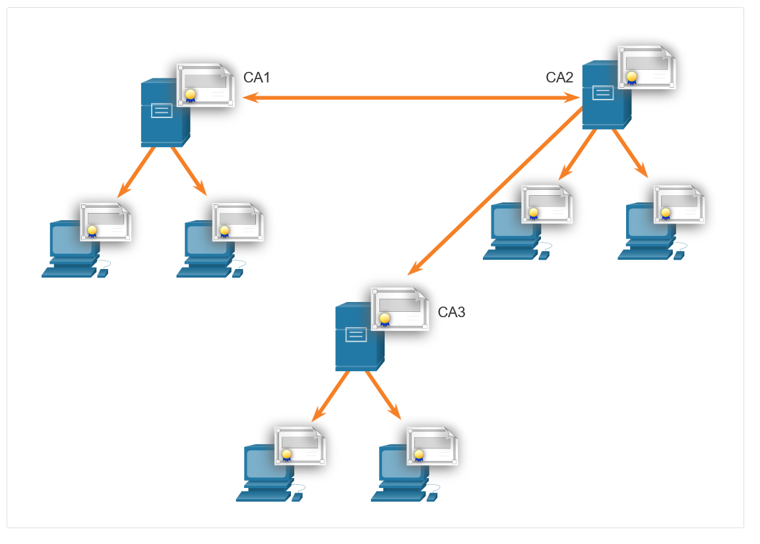
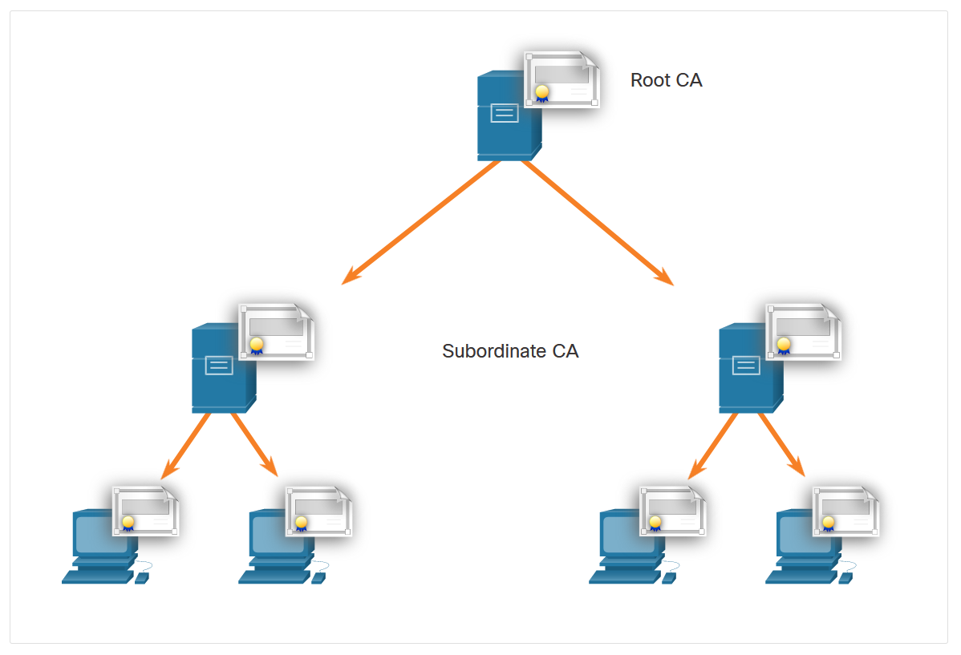
Public Key Cryptography
The PKI Trust System (Cont.)
On larger networks, PKI CAs may be linked using two basic architectures:
Cross-certified CA topologies
Hierarchical CA topologies
Cross-certified CA
Hierarchical CA
Notes:
17: Public Key Cryptography 17.2: Authorities and the PKI Trust System 17.2.4: The PKI Trust System

Slide 18
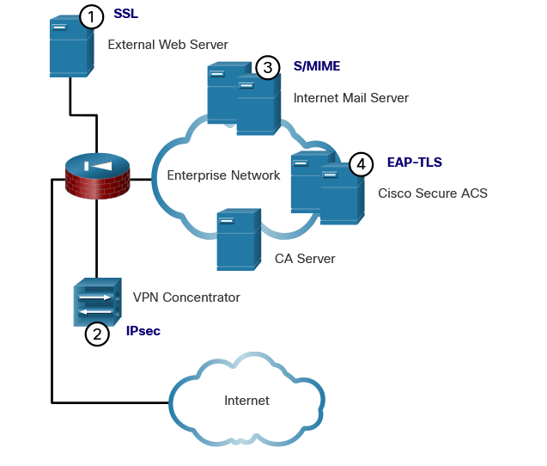
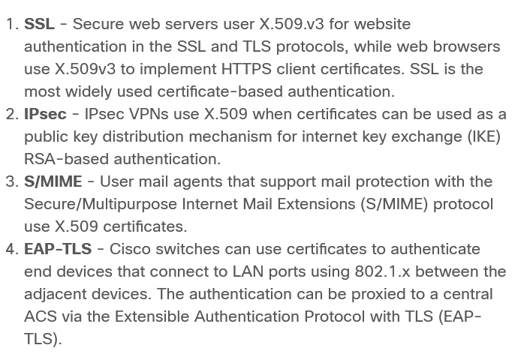
Public Key Cryptography
Interoperability of Different PKI Vendors
Interoperability between a PKI and its supporting services, such as Lightweight Directory Access Protocol (LDAP) and X.500 directories, is a concern because many CA vendors have proposed and implemented proprietary solutions instead of waiting for standards to develop.
To address this interoperability concern, the IETF published the Internet X.509 Public Key Infrastructure Certificate Policy and Certification Practices Framework (RFC 2527). The X.509 version 3 (X.509 v3) standard defines the format of a digital certificate.
Notes:
17: Public Key Cryptography 17.2: Authorities and the PKI Trust System 17.2.5: Interoperability of Different PKI Vendors

Slide 19
Public Key Cryptography
Certificate Enrollment, Authentication, and Revocation
All systems that leverage the PKI must have the CA’s public key, which is called the self-signed certificate. The CA public key verifies all the certificates issued by the CA and is vital for the proper operation of the PKI.
For many systems such as web browsers, the distribution of CA certificates is handled automatically.
The certificate enrollment process is used by a host system to enroll with a PKI. To do so, CA certificates are retrieved in-band over a network, and the authentication is done out-of-band (OOB) using the telephone.
Authentication no longer requires the presence of the CA server, and each user exchanges their certificates containing public keys.
Certificates must sometimes be revoked. The two of the most common methods of revocation are Certificate Revocation List (CRL) and Online Certificate Status Protocol (OCSP).
Notes:
17: Public Key Cryptography 17.2: Authorities and the PKI Trust System 17.2.6: Certificate Enrollment, Authentication, and Revocation

Slide 20
Public Key Cryptography
Lab - Certificate Authority Stores
In this lab, you will complete the following objectives:
Certificates Trusted by Your Browser
Checking for Man-In-Middle
Notes:
17: Public Key Cryptography 17.2: Authorities and the PKI Trust System 17.2.7: Lab - Certificate Authority Stores

Slide 21
17.3 Applications and Impacts of Cryptography
Notes:
17: Public Key Cryptography 17.3: Applications and Impacts of Cryptography

Slide 22
Applications and Impacts of Cryptography
PKI Applications
Where can PKI be used by an enterprise? The following provides a short list of common uses of PKIs:
SSL/TLS certificate-based peer authentication
Secure network traffic using IPsec VPNs
HTTPS Web traffic
Control access to the network using 802.1x authentication
Secure email using the S/MIME protocol
Secure instant messaging
Approve and authorize applications with Code Signing
Protect user data with the Encryption File System (EFS)
Implement two-factor authentication with smart cards
Securing USB storage devices
Notes:
17: Public Key Cryptography 17.3: Applications and Impacts of Cryptography 17.3.1: PKI Applications

Slide 23
Applications and Impacts of Cryptography
Encrypted Network Transactions
Threat actors can use SSL/TLS to introduce regulatory compliance violations, viruses, malware, data loss, and intrusion attempts in a network.
Other SSL/TLS-related issues may be associated with validating the certificate of a web server. When this occurs, web browsers will display a security warning. PKI-related issues that are associated with security warnings include:
Validity date range - The X.509v3 certificates specify “not before” and “not after” dates. If the current date is outside the range, the web browser displays a message. Expired certificates may simply be the result of administrator oversight, but they may also reflect more serious conditions.
Signature validation error - If a browser cannot validate the signature on the certificate, there is no assurance that the public key in the certificate is authentic. Signature validation will fail if the root certificate of the CA hierarchy is not available in the browser’s certificate store.
Notes:
17: Public Key Cryptography 17.3: Applications and Impacts of Cryptography 17.3.2: Encrypted Network Transactions

Slide 24
Applications and Impacts of Cryptography
Encryption and Security Monitoring
Network monitoring becomes more challenging when packets are encrypted.
However, the increased use of HTTPS in the enterprise network introduces new challenges. Because HTTPS introduces end-to-end encrypted HTTP traffic (via TLS/SSL), it is not as easy to peek into user traffic.
Here is a list of some of the things that a security analyst could do:
Configure rules to distinguish between SSL and non-SSL traffic, HTTPS and non-HTTPS SSL traffic.
Enhance security through server certificate validation using CRLs and OCSP.
Implement antimalware protection and URL filtering of HTTPS content.
Deploy a Cisco SSL Appliance to decrypt SSL traffic and send it to intrusion prevention system (IPS)
Notes:
17: Public Key Cryptography 17.3: Applications and Impacts of Cryptography 17.3.3: Encryption and Security Monitoring

